Slide 1
XG Boosting Algorithm
XG Boost (Extreme Gradient Boosting) is a powerful and popular machine learning algorithm that excels in both classification and regression tasks. It’s known for its high performance and efficiency.
This estimator builds an additive model in a forward stage-wise fashion; it allows for the optimization of arbitrary differentiable loss functions. In each stage a regression tree is fit on the negative gradient of the given loss function. Enhance gradient boosting with optimizations for efficiency and accuracy.

Slide 2
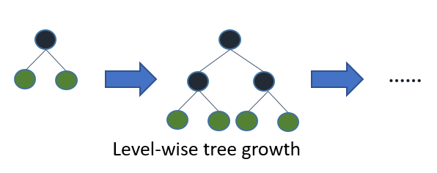
XG Boost Diagram

Slide 3
XG Boost:
XG Boost (Extreme Gradient Boosting) is a powerful ensemble learning algorithm that is particularly effective for regression tasks.
It builds a predictive model by combining the predictions of multiple individual models, often referred to as "weak learners" or "base learners," to create a strong, accurate model
XG boost algorithm the trees grow level wise

Slide 4
Hyperparameter Tuning:
Fine-tuning hyperparameters like max_depth, learning_rate, n_estimators and others can significantly impact the model's performance.
XGBoost's strength lies in its ability to handle complex relationships in the data, provide feature importance scores, and perform well on a wide range of regression problems.
However, it requires careful hyperparameter tuning and might be computationally intensive depending on the dataset size and complexity.

